Slide 1

Capstone Project
Play Store App Review Analysis
By
Sabitendu Mahapatra
GitHub Link-- https://github.com/sabitendu/EDA-Capstone-Project-on-Play-Store-App-Review-Analysis

Slide 2
INDEX
Introduction
Objective
Data Preparation
Attributes in Google Play store Data
Attributes in User reviews
Count of Applications in each category
Distributions of Review and Installation
Type and Content Rating Distribution
Distribution of Size
Analysis of Rating
Analysis of Sentiment, Sentiment Polarity and Sentiment Subjectivity
Size vs Install Relation
Android version vs Installs
Sentiment Polarity vs Sentiment subjectivity
Sentiment Polarity distribution in each Rating Category
Pair plot of play store data
Correlation of play store data
Correlation of merged data frame
How sentiment polarity affect in Rating?
Solution of Business Objective
Challenges Faced
Conclusions
Reference

Slide 3
Introduction
Importance of Mobile App is increasing daily
Designer should aware the path of the success of the app
Two dataset available for the analysis: play store data and user review data
Play Store data have 10841 rows and 13 columns
User review data has 64295 rows and 5 columns

Slide 4
Objective
Find the path of success of the app
Find the user’s choice , preference and sentiment
Find the important features

Slide 5
Data Preparation
Load the data sets: Two datasets, First Play store app dataset and User Reviews dataset.
Import Libraries: NumPy, Pandas, Seaborn and Matplotlib
Data cleaning: Null values, Finding and removing Outliers, Removing duplicate data.
Data Imputation: Filling the missing categorical values with mode and numerical values with median. Conversion of price, installs, reviews into numerical values
Data Reshaping: Change the datatype for appropriate analysis

Slide 6
Attributes in Google Play store Data
App :
Category :
Rating :
Reviews :
Size :
Installs:
Type :
Price:
Content Rating:
Genres:.
Last Updated:
Current Version:
Android Version:

Slide 7
Attributes in User reviews
App
Translated Review
Sentiment
Sentiment Polarity
Sentiment Subjectivity

Slide 8
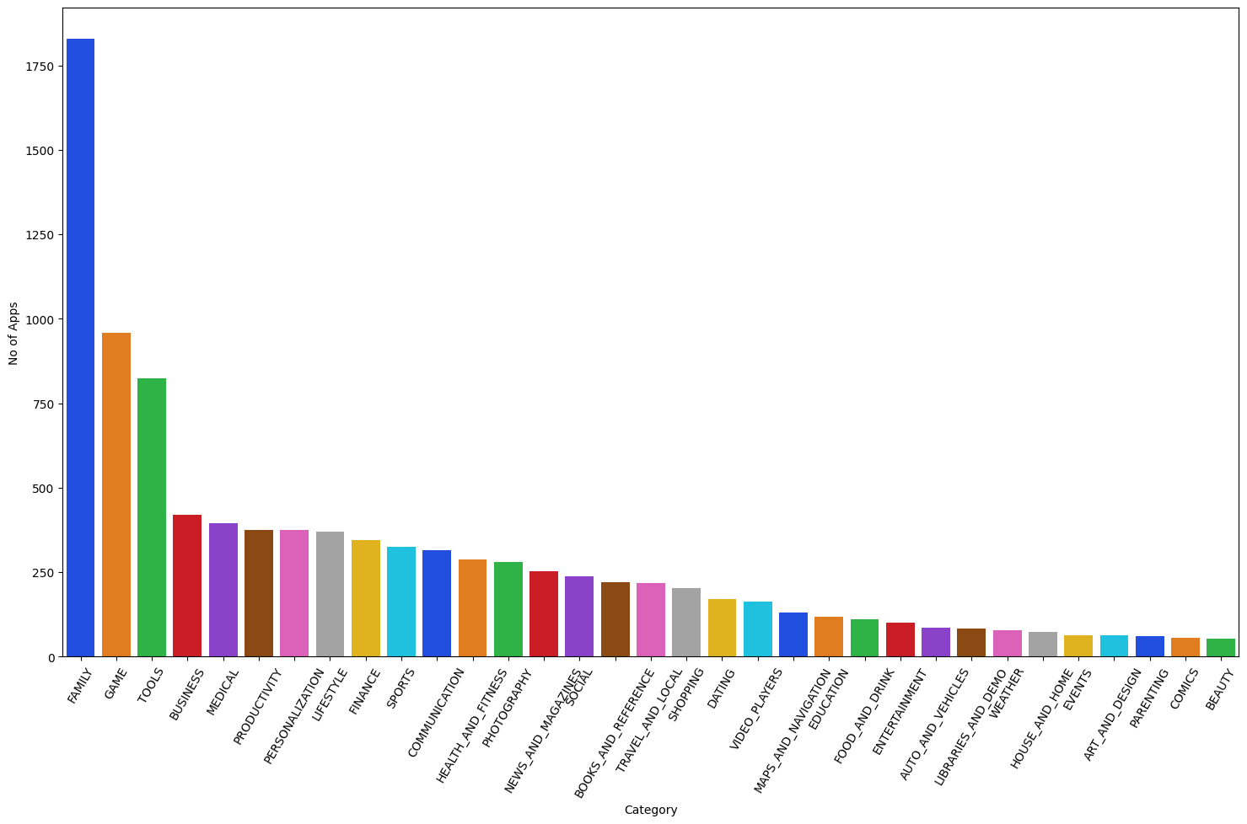
Count of Applications in each category
Family and Game apps have the
highest market prevalence. Tools, Business and Medical apps are also at the Top Count of applications

Slide 9
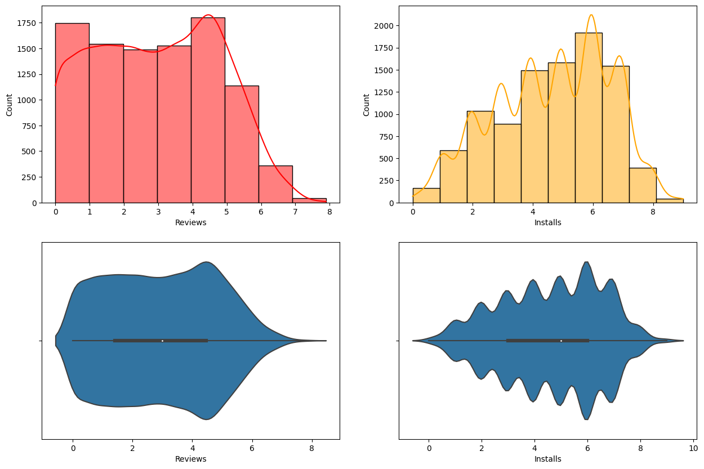
Distributions of Review and Installation
Most of apps has 250 to 29445 reviews and 1000 to 1M no of installation
Median value of Reviews are 969
Median value of installation is 10000

Slide 10
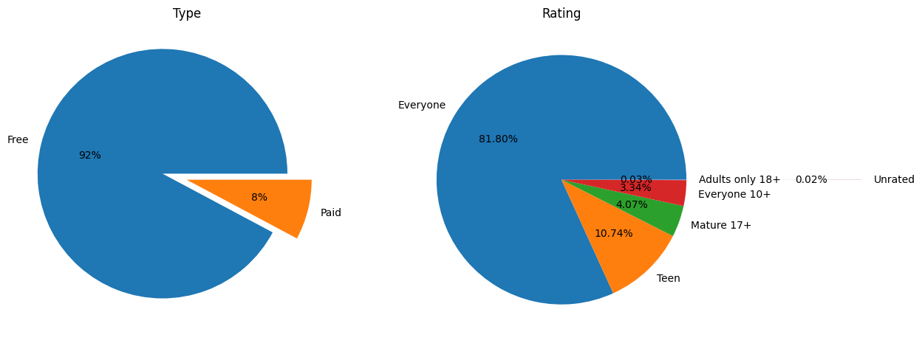
Type and Content Rating Distribution

Slide 11
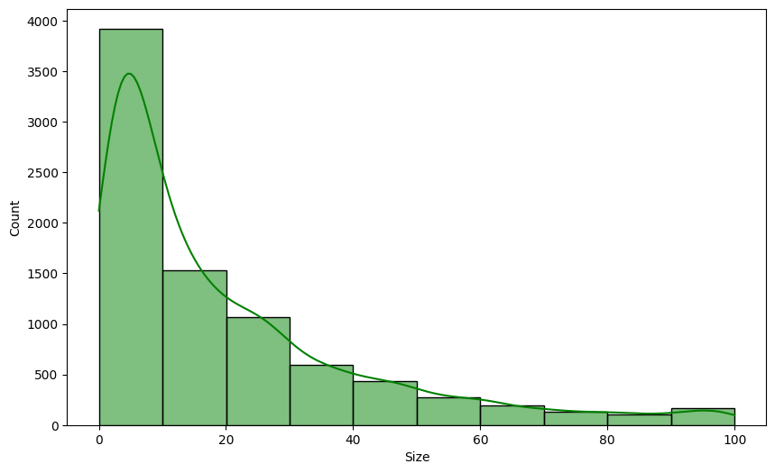
Distribution of Size
Negative skewed
Most of size are lies between 4.6MB to 28MB

Slide 12
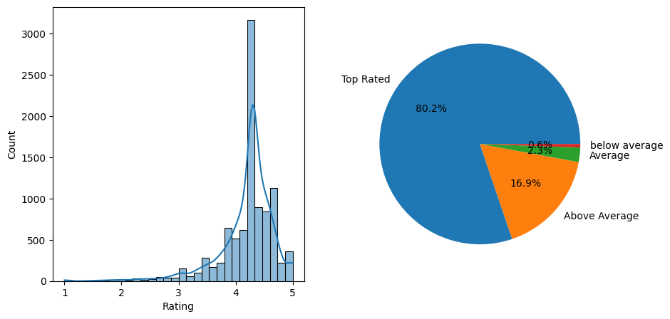
Analysis of Rating
Top Rated-4.0-5.0
Above Average-3.0-4.0
Average-2.0-3.0
Below Average-1.0-2.0

Slide 13
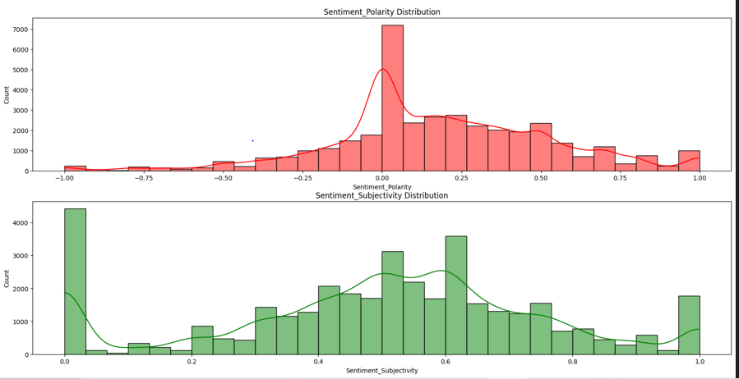
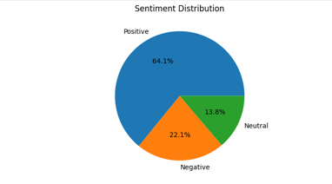
Analysis of Sentiment, Sentiment Polarity and Sentiment Subjectivity

Slide 14
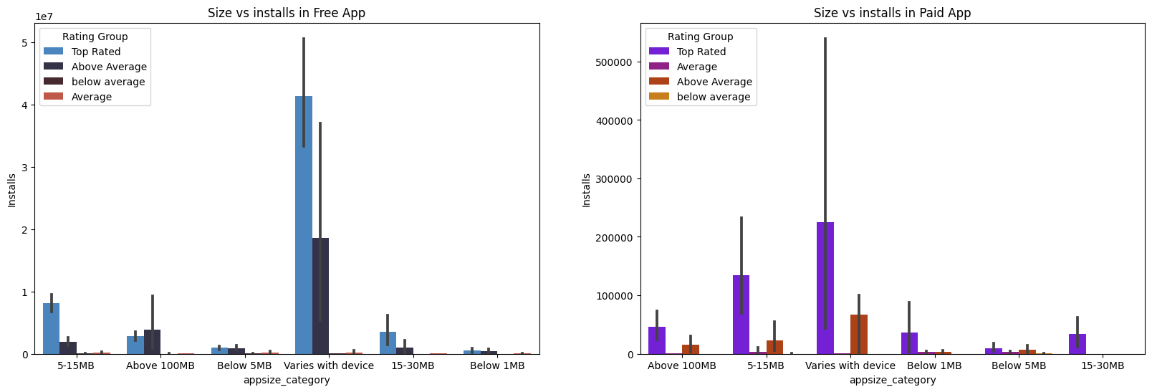
Size vs Install Relation

Slide 15
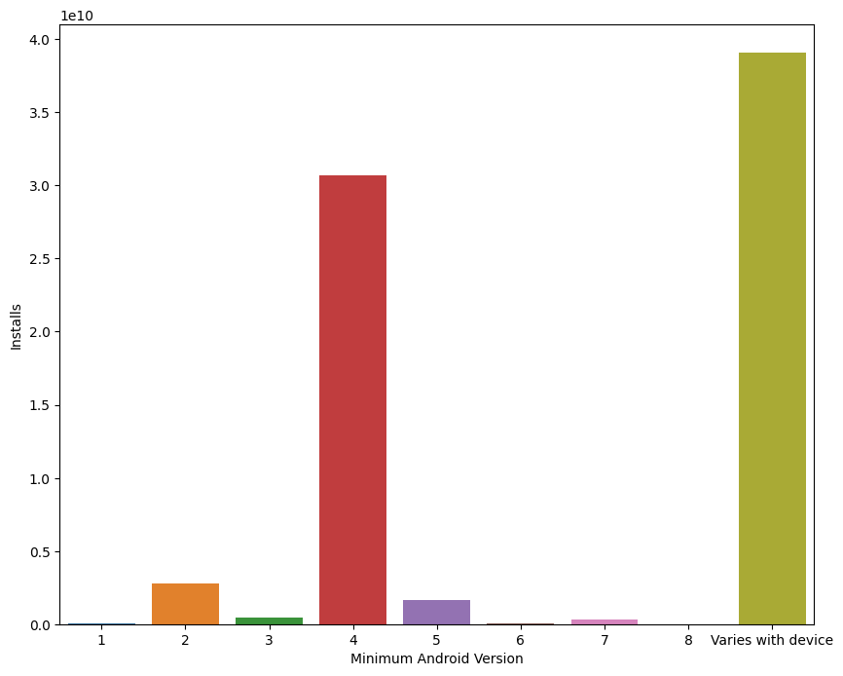
Android version vs Installs

Slide 16
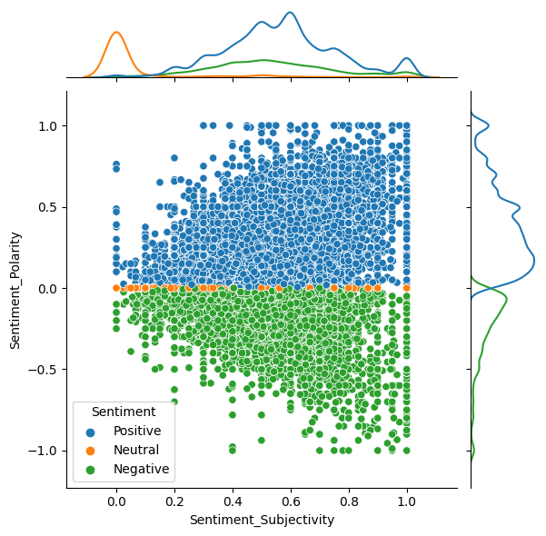
Sentiment Polarity vs Sentiment Subjectivity

Slide 17
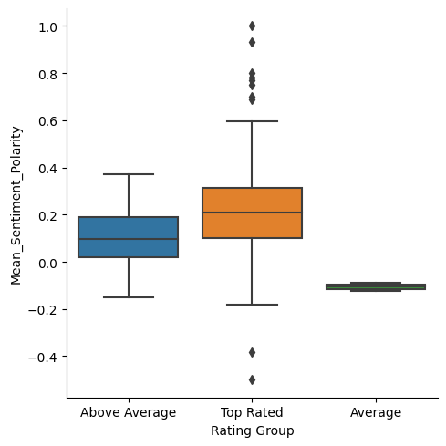
Sentiment Polarity distribution in each Rating Category

Slide 18
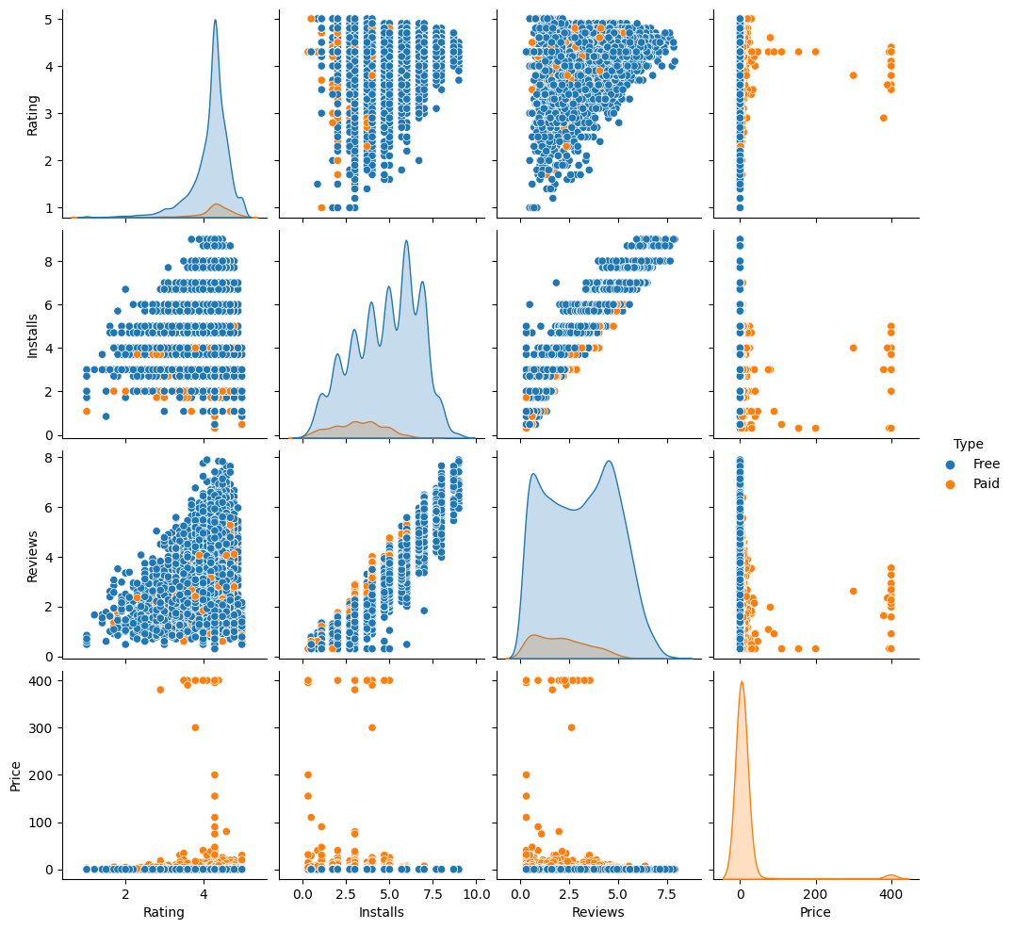
Pair plot of play store data

Slide 19
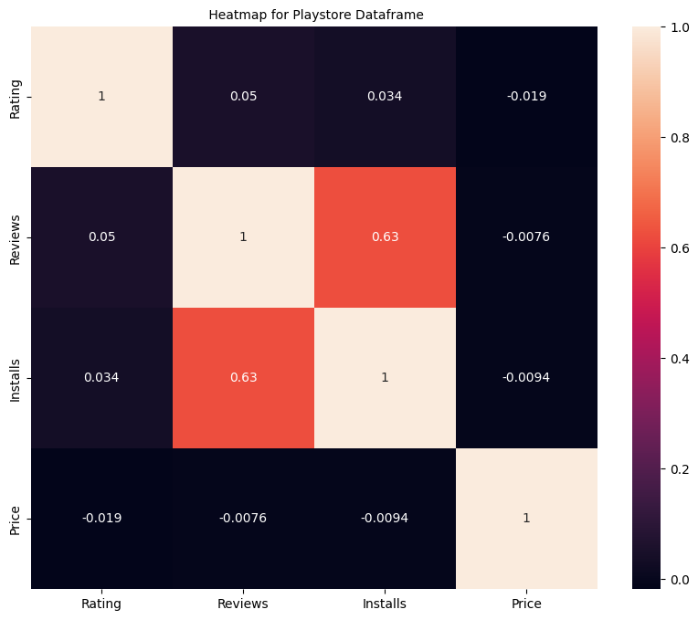
Correlation of play store data

Slide 20
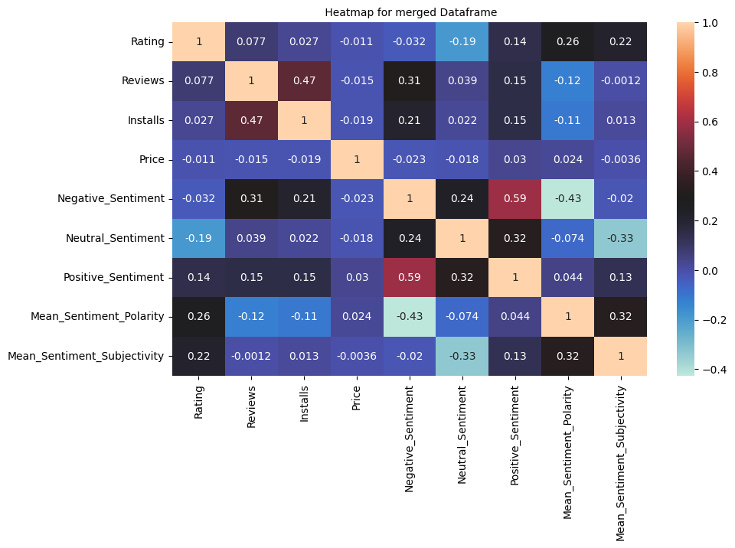
Correlation of merged data frame

Slide 21
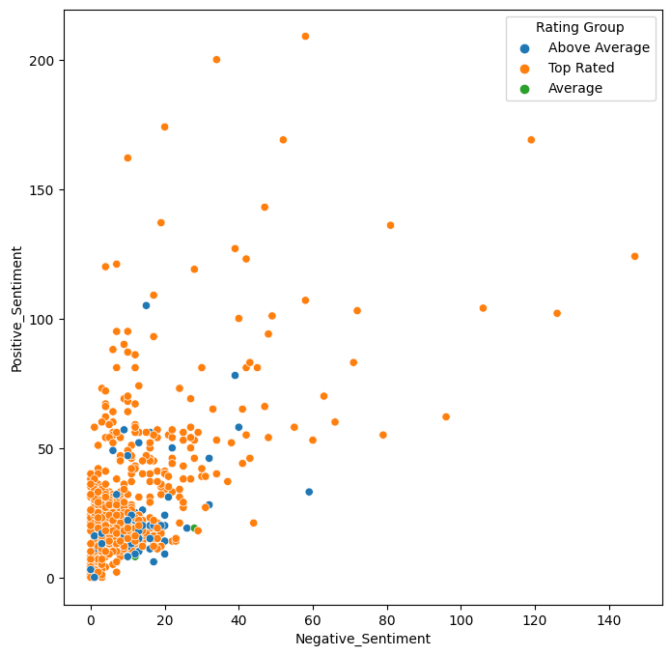
How sentiment polarity affect in Rating?

Slide 22
Solution of Business Objective
Most of the apps are free (92%). So the developer should focus on making the app free to achieve a high customer base. But if the app is paid, then try to set the price below $50.
The categories of apps should be like events, beauty, and parenting because these categories are less explored. The number of apps is less, but installation is pretty high.
, App size does not has large impact on installation.
The preferred content rating for everyone and the preferred genre should be communications, tools, photography, and social.
Android version is preferred to be variable with the device or Android 4.
If the category is games, the developer should be cautious because it has the most negative reviews.
The app should be updated over time with respect to user preferences and overcome the issues mentioned in reviews.
The target audience of the app should be top-rated, which means above 4.0, and installation should be around 10 lakh.

Slide 23
Challenges Faced
Handling the error, duplicate values in the dataset.
13.60% of reviews were Null values, we could not infer much in order to fill them. Thus we had to drop them.
User Reviews had 42% of Null values, and we had to drop them for in sufficient infernce
The merged data frame of both play store and user reviews, had only 816 common apps. This is just 10% of the cleaned data, we could have given more valuable analysis, if we had at least 70% - 80% of the data available in the merged data frames.

Slide 24
Conclusion
Facebook is the most popular App in the play store.
Helix jumps is the most positive reviewed apps and angry birds classic is the most negative reviewed apps.
When app has high positive and negative review the rating got high that means when it has updated it had overcome the negative subjectivity
around 3000 apps has not updated over few years, that means probably that number of are out of services
Paid apps are generally high rated than free apps in each category except parenting category.
When the app size very high they are few numbered but installation number is high.
Current version, Last Update, Sentiment subjectivity should be analyzed for effect in rating and installation
The data journey of the app(installation, rating, review) over the year should have help to understand business more effectively.

Slide 25
Reference
Geeksforgeeks
W3schools
Statology
Analytics Vidya
Towardsdatascience
Python libraries documentation
Stackoverflow

Slide 26


